Slide 1
M9

Slide 2
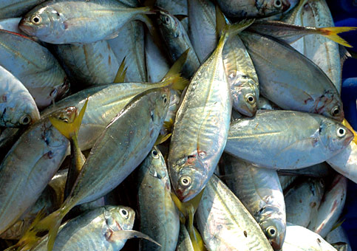
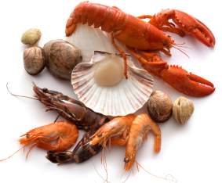
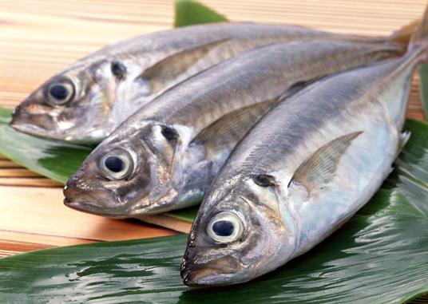
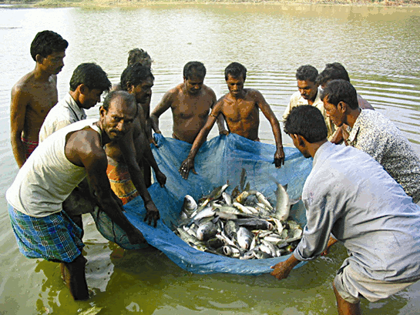
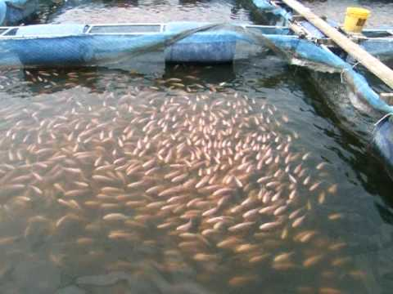
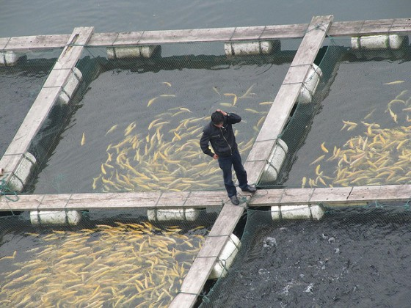
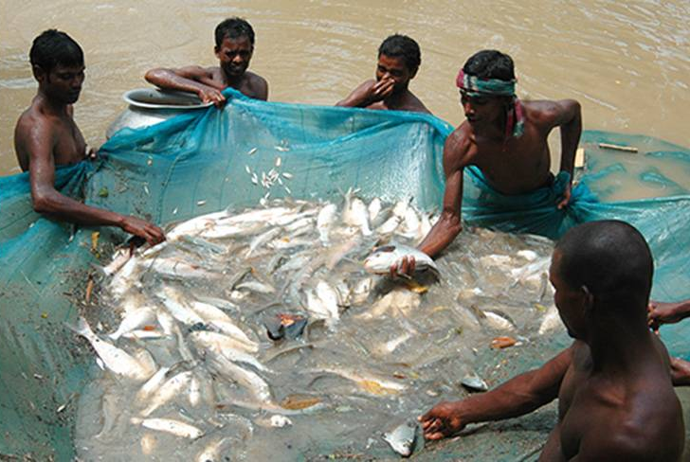
Fish production :
Fish is a cheap source of animal protein for our food.
Fish production includes the finned true fish
as well as shellfish such as prawns and molluscs.
There are two ways of obtaining fish.
One is from natural resources :
Called as capture fishing.
The other way is by fish farming :
Which is called culture fishery.

Slide 3
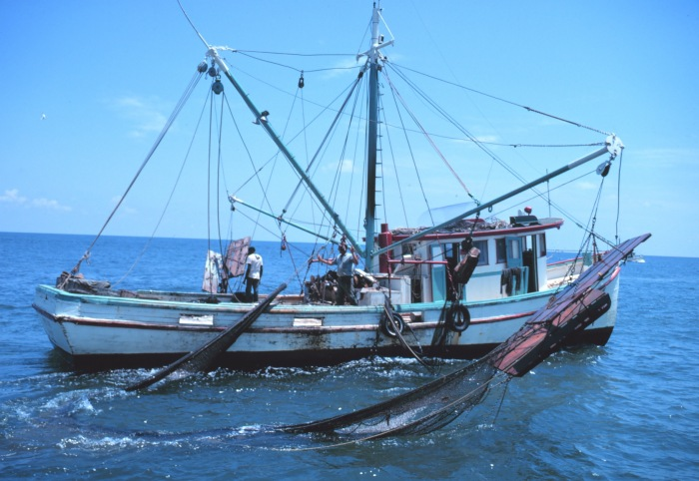
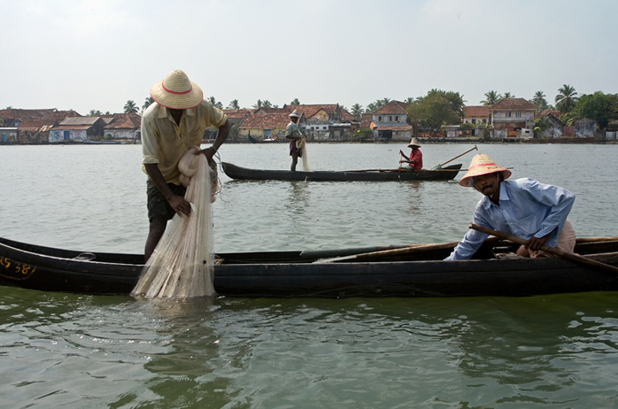
Fish production :
The water source of the fish can be either seawater or fresh water, such as in rivers and ponds.
Fishing from sea water is called marine fisheries.
And fishing from fresh water is called inland fisheries.
Let us first understand marine fisheries :

Slide 4
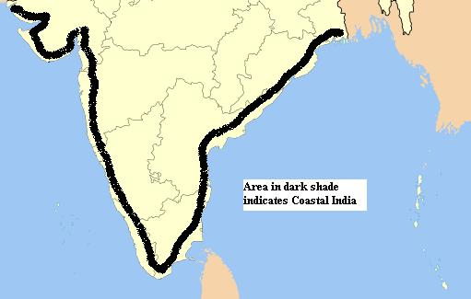
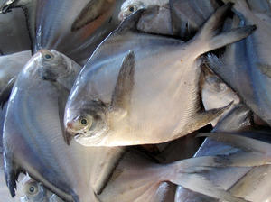
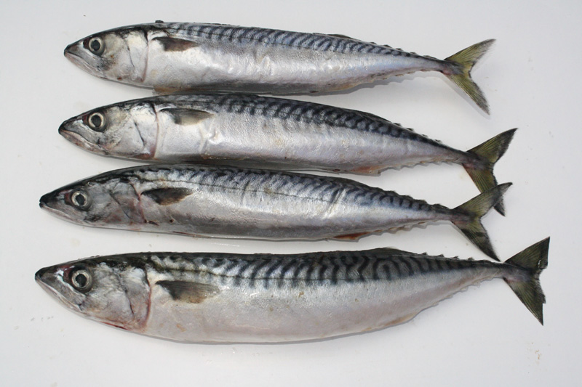
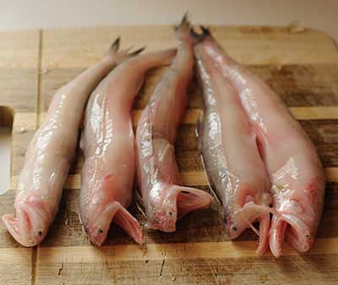
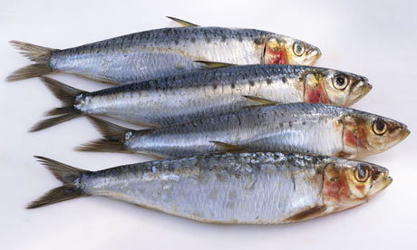
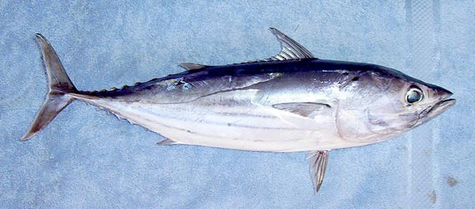
Marine fisheries :
India’s marine fishery resources include 7500 km of coastline and the deep seas beyond it.
Popular marine fish varieties include pomphret,
mackerel,
tuna,
sardines,
and Bombay duck.

Slide 5
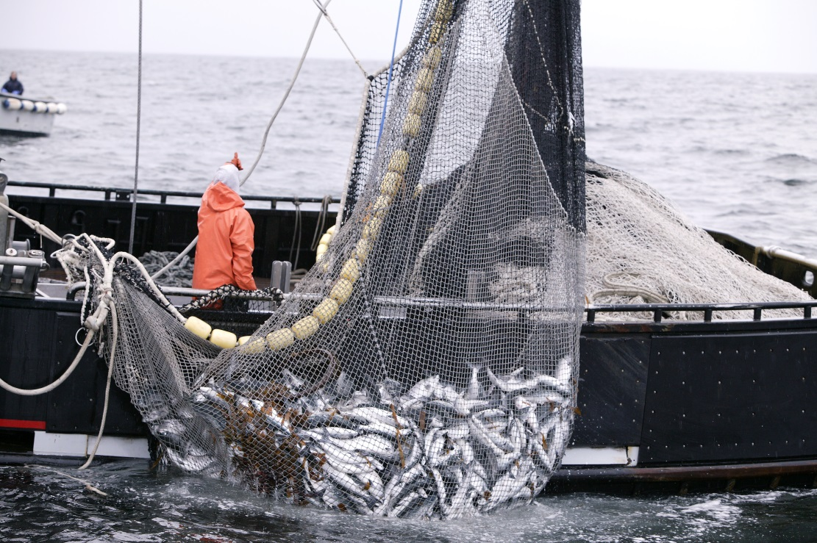
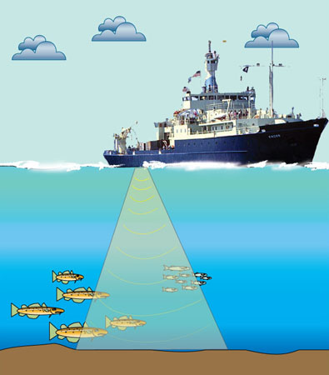
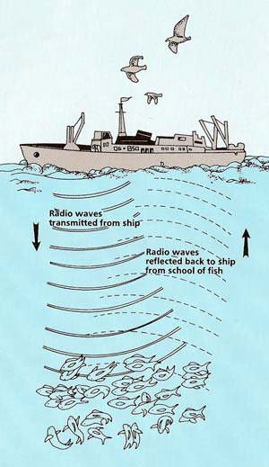
Marine fisheries :
Marine fish are caught using many kinds of fishing nets from fishing boats.
Yields are increased by locating large schools of fish in the open sea using satellites and echo-sounders.

Slide 6
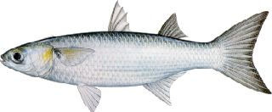
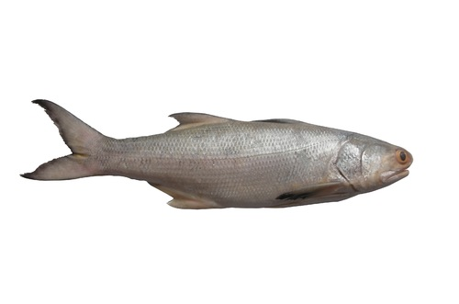
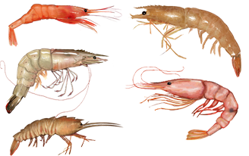
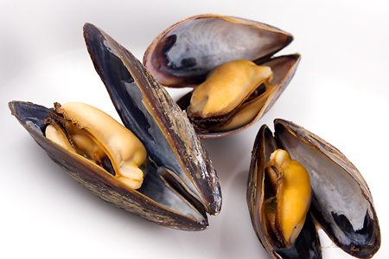
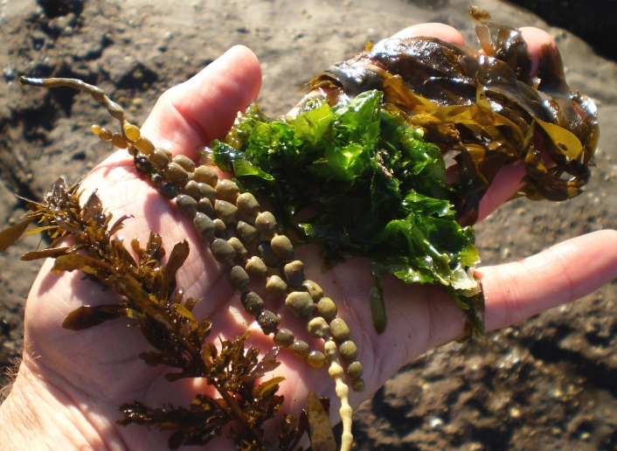
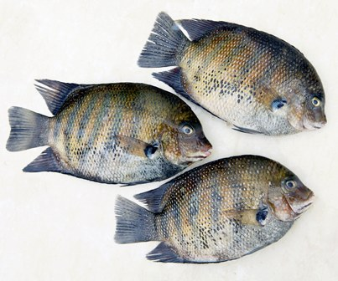
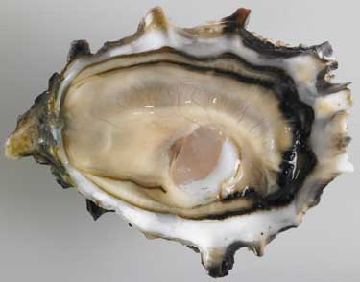
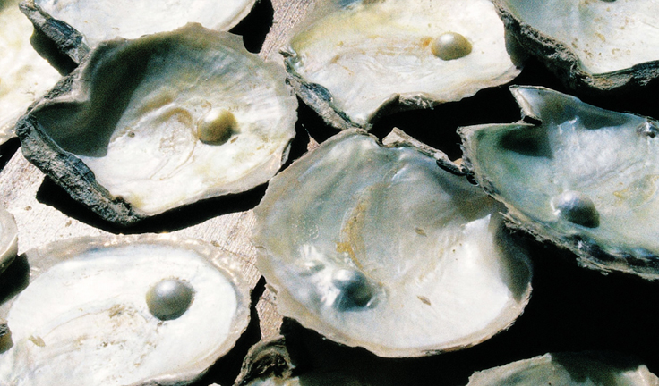
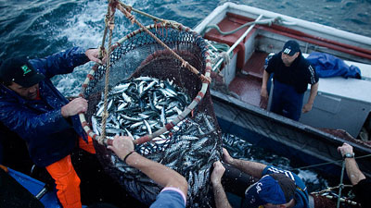
Marine fisheries :
Some marine fish of high economic value are also farmed in seawater.
This includes finned fishes like mullets,
bhetki
and pearl spots,
shellfish such as prawns,
mussels
and oysters
as well as seaweed.
Oysters are also cultivated for the pearls they make.
As marine fish stocks get further depleted, the demand for more fish can only be met by such culture fisheries, a practice called mariculture.

Slide 7
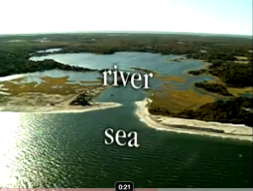
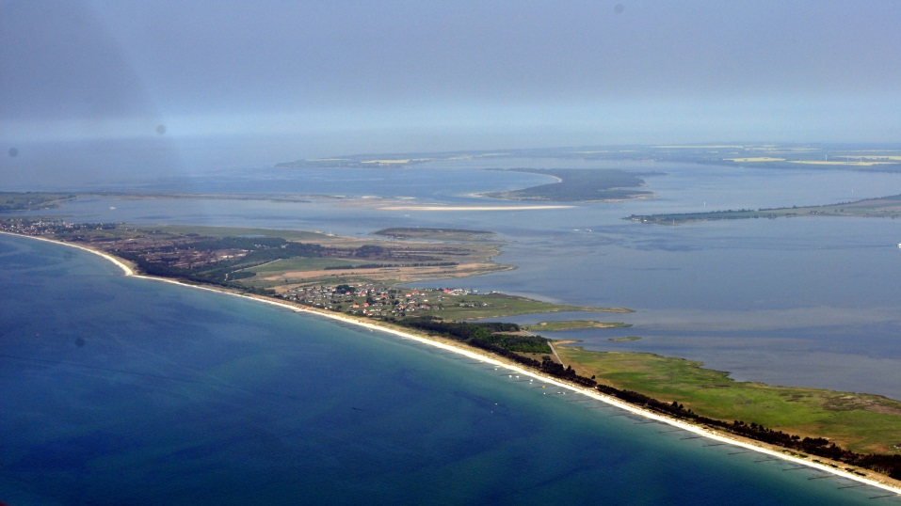
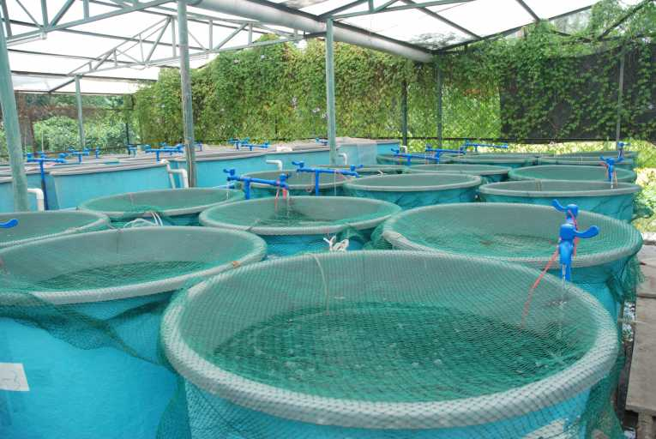
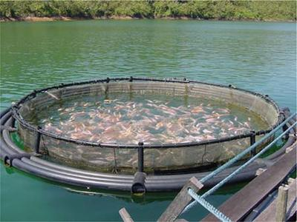
Inland fisheries :
Fresh water resources include canals, ponds, reservoirs and rivers.
Brackish water resources, where seawater and fresh water mix together, such as estuaries and lagoons are also important fish reservoirs.
shallow bodies of water separated from the ocean by a series of barrier islands
The area where river meets the sea
While capture fishing is also done in such inland water bodies, the yield is not high.
Most fish production from these resources is through aquaculture.

Slide 8
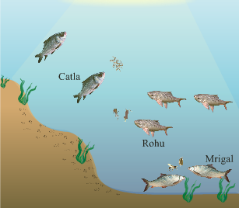
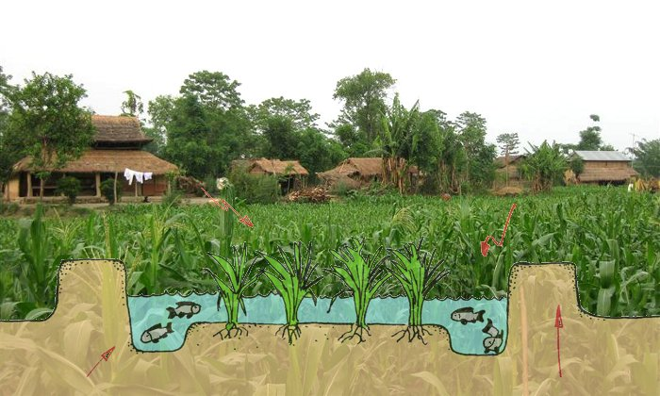
Inland fisheries :
Fish culture is sometimes done in combination with a rice crop, so that fish are grown in the water in the paddy field.
More intensive fish farming can be done in composite fish culture systems.
Growing different fishes with different food habits
Both local and imported fish species are used in such systems.

Slide 9
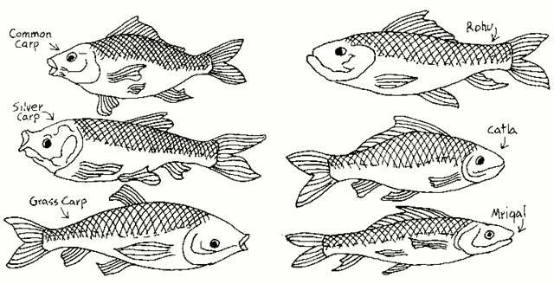
Inland fisheries :
In such a system, a combination of five or six fish species is used in a single fishpond.
These species are selected so that they do not compete for food among them having different types of food habits.
As a result, the food available in all the parts of the pond is used.

Slide 10
Inland fisheries :
For example catlas are surface feeders,
Rohus feed in the middle-zone of the pond,
Grass Carps feed on the weeds,
Mrigals and Common Carps are bottom feeders,
So together these species can use all the food in the pond without competing with each other.
This increases the fish yield from the pond.

Slide 11
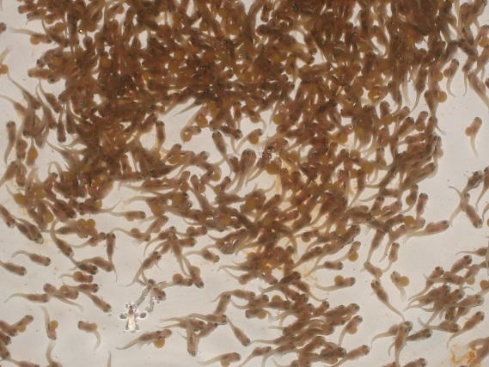
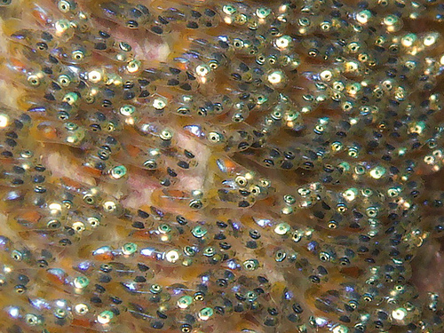
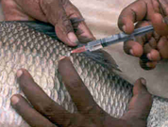
Inland fisheries :
One problem with such composite fish culture is that many of these fish breed only during monsoon.
Even if fish seed is collected from the wild, it can be mixed with that of other species as well.
Eggs or young ones of a fish
So, a major problem in fish farming is the lack of availability of good quality seed.
To overcome this problem, ways have now been worked out to breed these fish in ponds using hormonal stimulation.
This has ensured the supply of pure fish seed in desired quantities.

